Slide 1
Simple Linux
Network programming
2019/09/17

Slide 2
Outline
Introduction of virtual machines and an installation tutorial
How to connect to a remote machine ?
Basic Linux commands
Basic Linux programming
Networking tools on Linux

Slide 3
Outline
Introduction of virtual machines and an installation tutorial
How to connect to a remote machine ?
Basic Linux commands
Basic Linux programming
Networking tools on Linux

Slide 4
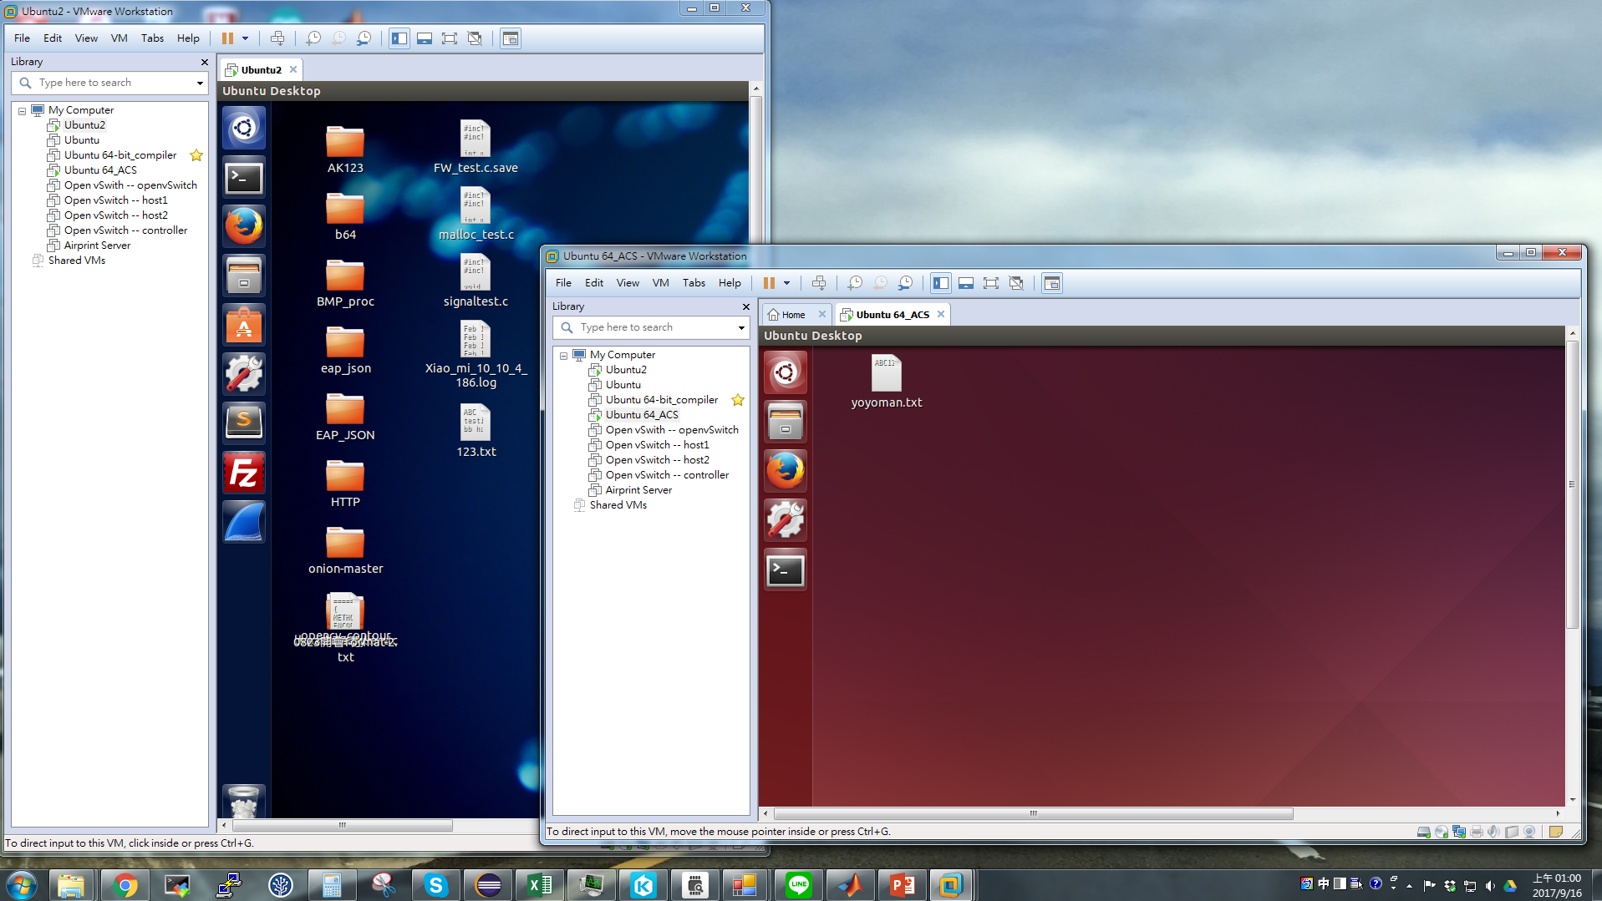
Virtual Machines

Slide 5
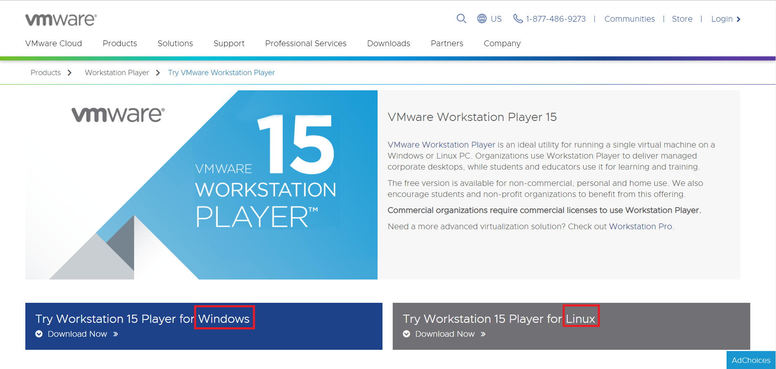
Install VMware Workstation
Download VMware workstation
https://www.vmware.com/products/player/playerpro-evaluation.html
Or google VMware workstation player

Slide 6
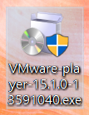
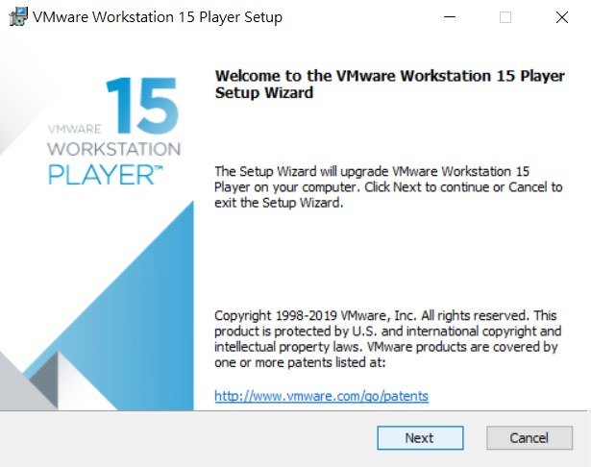
Install VMware Workstation
Click the program you have downloaded
Click “Next” to continue installation

Slide 7
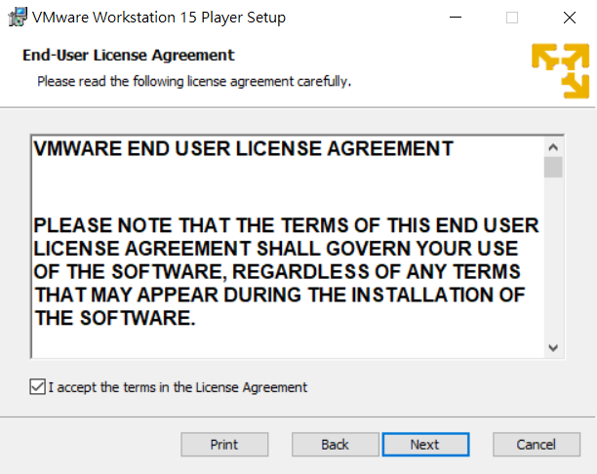
Install VMware Workstation
Click “I accept the terms in the license Agreement” and then “Next”

Slide 8
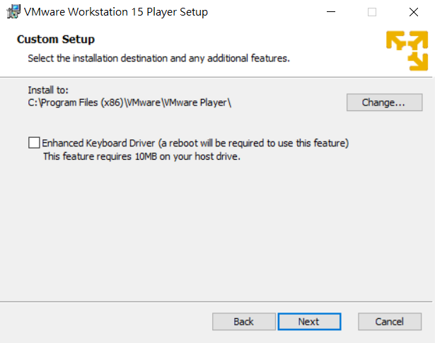
Install VMware Workstation
Click “Next” if you accept the default setup

Slide 9
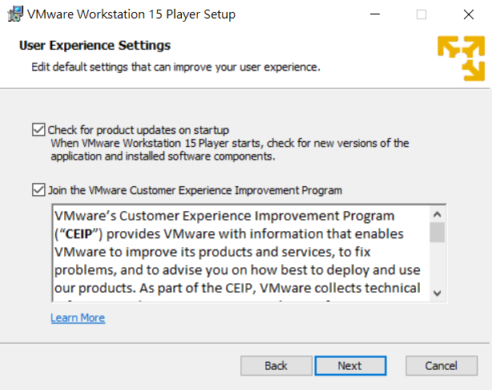
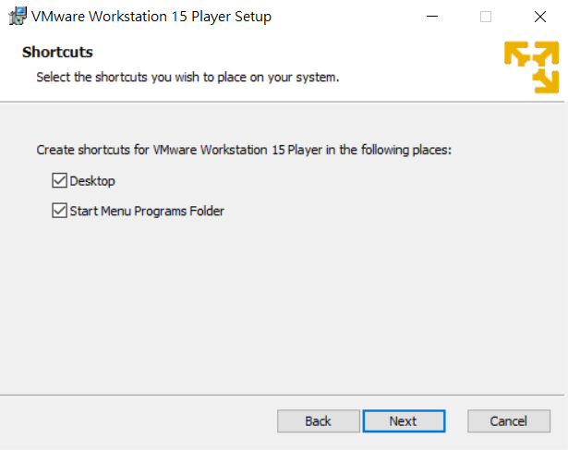
Install VMware Workstation
Click “Next” if you accept the default setup

Slide 10
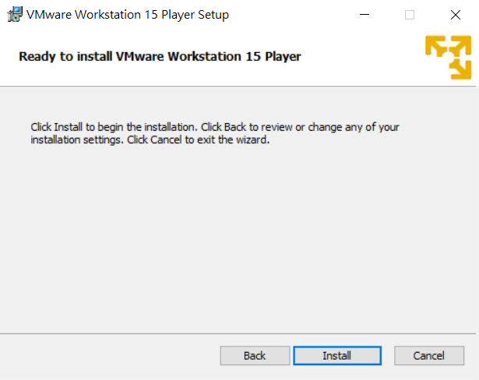
Install VMware Workstation
Click “Install” to start the installation

Slide 11
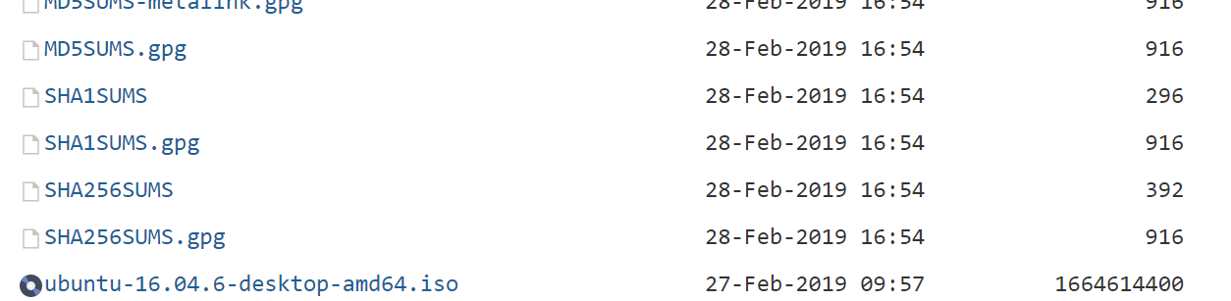
Install the Guest OS
Install the guest OS
Download the Linux distribution you like
In this tutorial, I will use Ubuntu 16.04 LTS
Download Ubuntu from here: http://ubuntu.cs.nctu.edu.tw/ubuntu-release/16.04/

Slide 12
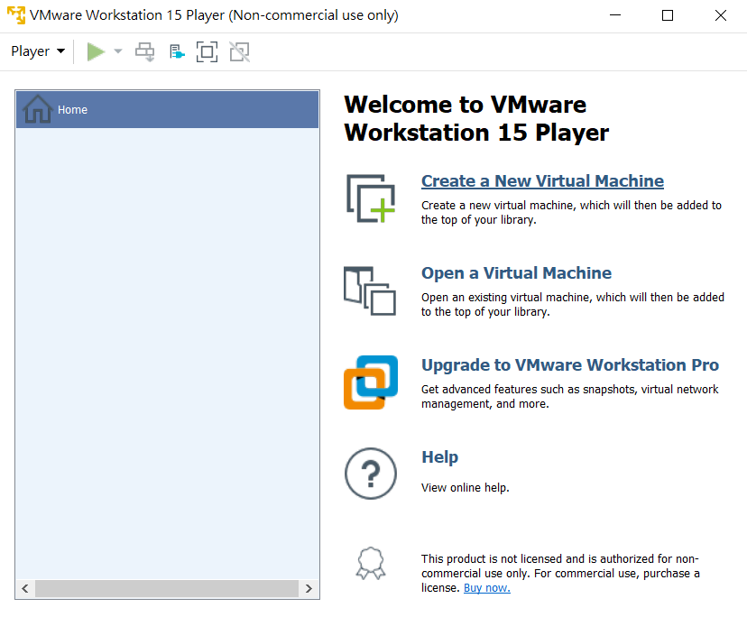
Install the Guest OS
Back to VMware workstation player
Click “Create a New Virtual Machine”

Slide 13
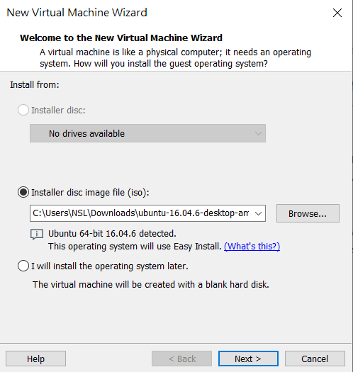
Install the Guest OS
Choose “Installer disc image file(iso)” and press “Browse” to find the ISO file you download from website
Press “Next” to continue

Slide 14
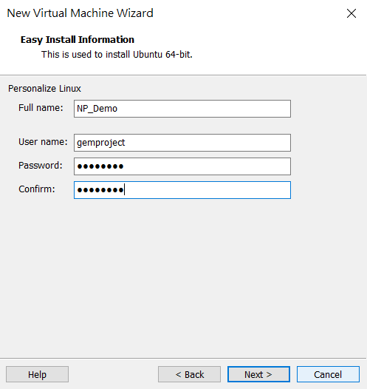
Install the Guest OS
Enter the user name and the password for your guest machine
Press “Next”

Slide 15
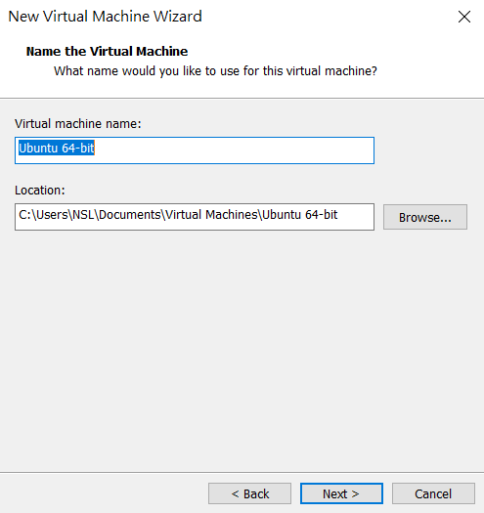
Install the Guest OS
Click “Next” if you accept default setup

Slide 16
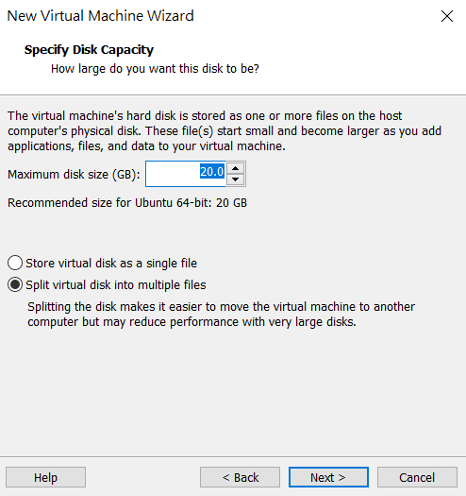
Install the Guest OS
Set the maximum disk size of your guest OS
Choose “Split virtual disk into multiple files”
Click “Next”

Slide 17
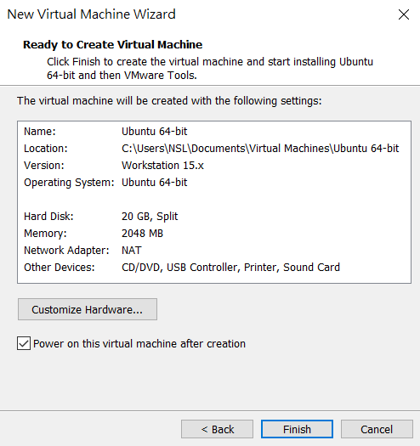
Install the Guest OS
Press “Finish” if you accept default setup
The guest OS will be powered on automatically.

Slide 18
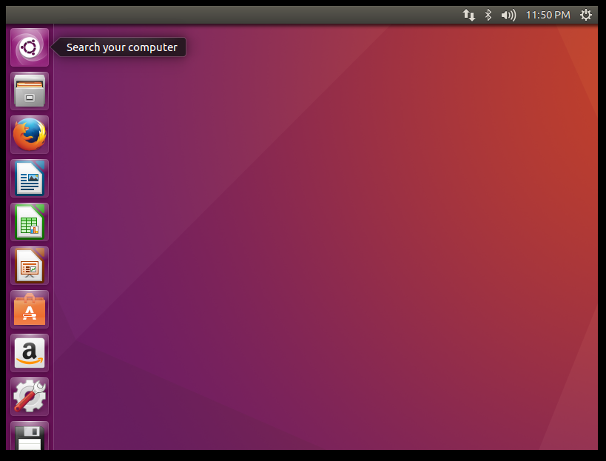
Install the Guest OS
After waiting for a while, you can get a whole new guest OS on your computer.

Slide 19
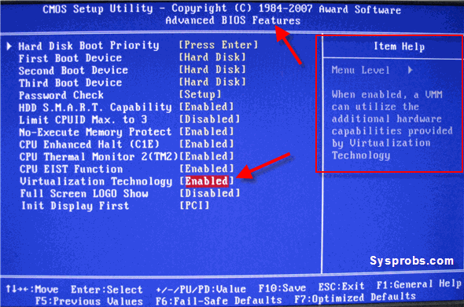
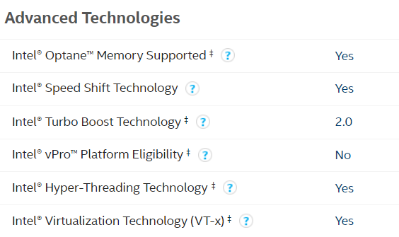
Common Problems
Get error message: This host does not support Intel VT-x
Solution:
First of all, do make sure that your computer is 64-bit
Check whether your CPU supports VT-X or not, if your CPU is Intel, you can check here: http://ark.intel.com/Search/FeatureFilter?productType=processors
If your CPU does support it, you can enable it in the BIOS
If your CPU doesn’t support it, it’s OK to install 32-bit guest OS on your computer.

Slide 20
Outline
Introduction of virtual machines and an installation tutorial
How to connect to a remote machine ?
Basic Linux commands
Basic Linux programming
Networking tools on Linux

Slide 21
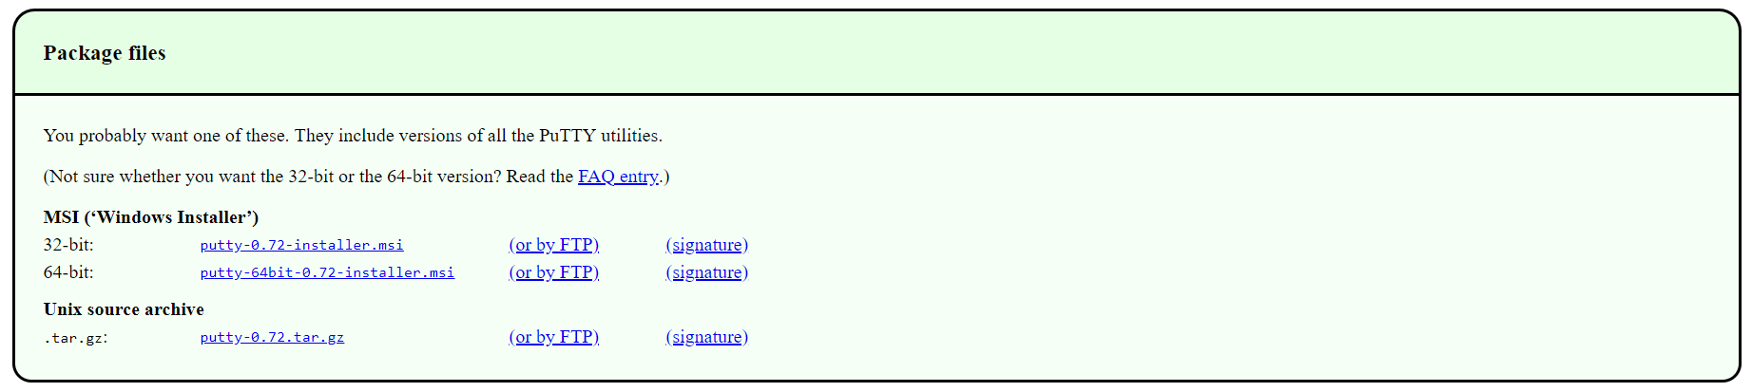
To start with...
Download putty.exe
http://www.chiark.greenend.org.uk/~sgtatham/putty/download.html
Or google putty

Slide 22
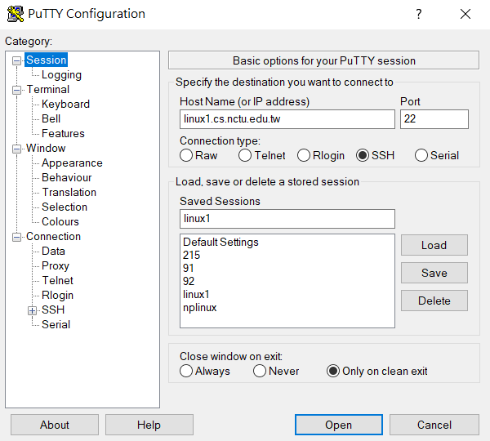
To start with... (Continued)
linux1.cs.nctu.edu.tw
linux2.cs.nctu.edu.tw
linux3.cs.nctu.edu.tw
linux4.cs.nctu.edu.tw
linux5.cs.nctu.edu.tw
linux6.cs.nctu.edu.tw

Slide 23
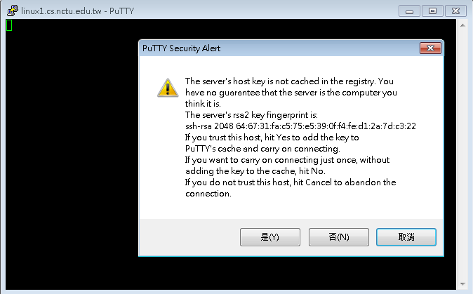
To start with... (Continued)

Slide 24
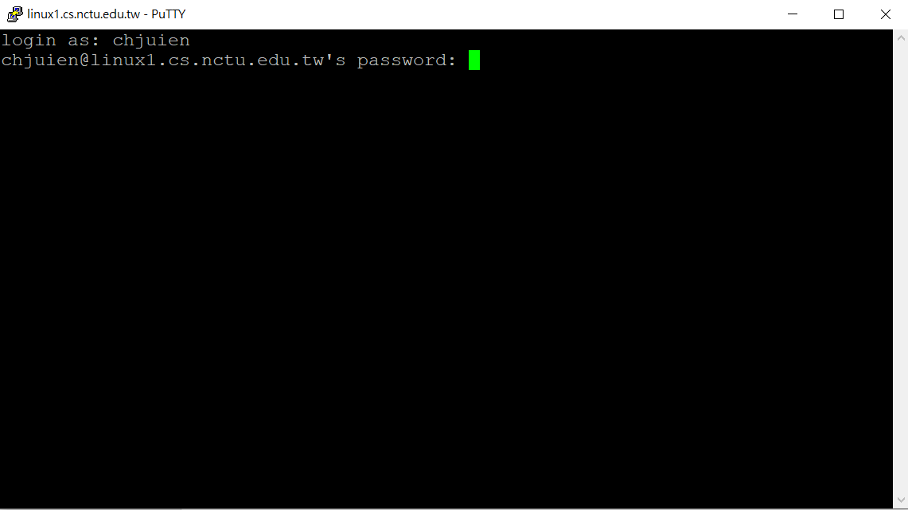
To start with... (Continued)

Slide 25
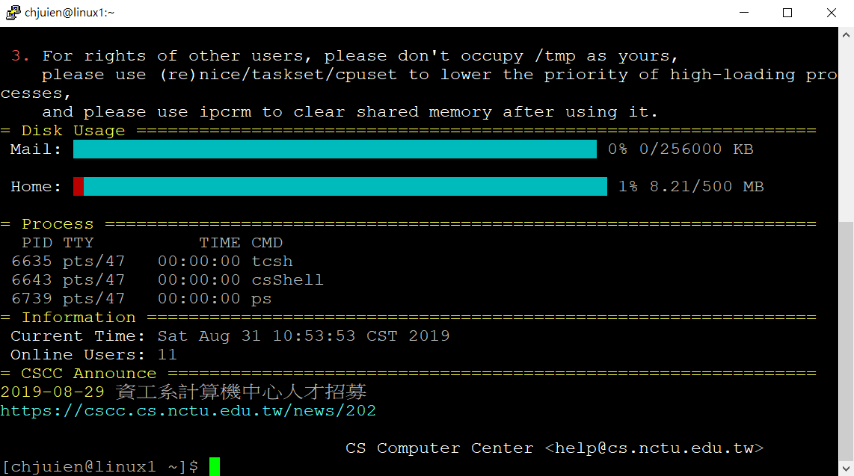
To start with... (Continued)

Slide 26
Outline
Introduction of virtual machines and an installation tutorial
How to connect to a remote machine ?
Basic Linux commands
Basic Linux programming
Networking tools on Linux

Slide 27
Basic Linux commands
command | explanation | 中文解釋
ls | List directory contents | 把現在資料夾下的檔案顯示出來
pwd | Print name from working directory | 看現在在哪個資料夾底下
mkdir <dir> | Make directories | 建立資料夾
cd <dir> | Change directory | 換資料夾
mv <src file> <dst file> | Move (rename) file | 移動檔案 (重新命名) 檔案
cp <src file> <dst file> | Copy file | 複製檔案
rm <file> | Remove file | 刪除檔案
clear | Clean up the screen | 把畫面清乾淨

Slide 28
Directory Listing
account@server hostname [current directory]
You can type “ls”, which means “list “, to show all the files in the home directory.
command | explanation
ls ~ | List contents in user home directory.
ls . | List contents in current directory.
ls .. | List contents in parent directory.

Slide 29
The ‘man’ Command
Use command ‘man’ to discover more usages.
man ls
ls –a : show all files, including files starting with . , which are hidden files.
ls -l : show long information of contents.
ls –al : show all the files and their long information.
ls <path> : show the content of given path
You can also man the function you may use in the program.
man printf
man strtok

Slide 30
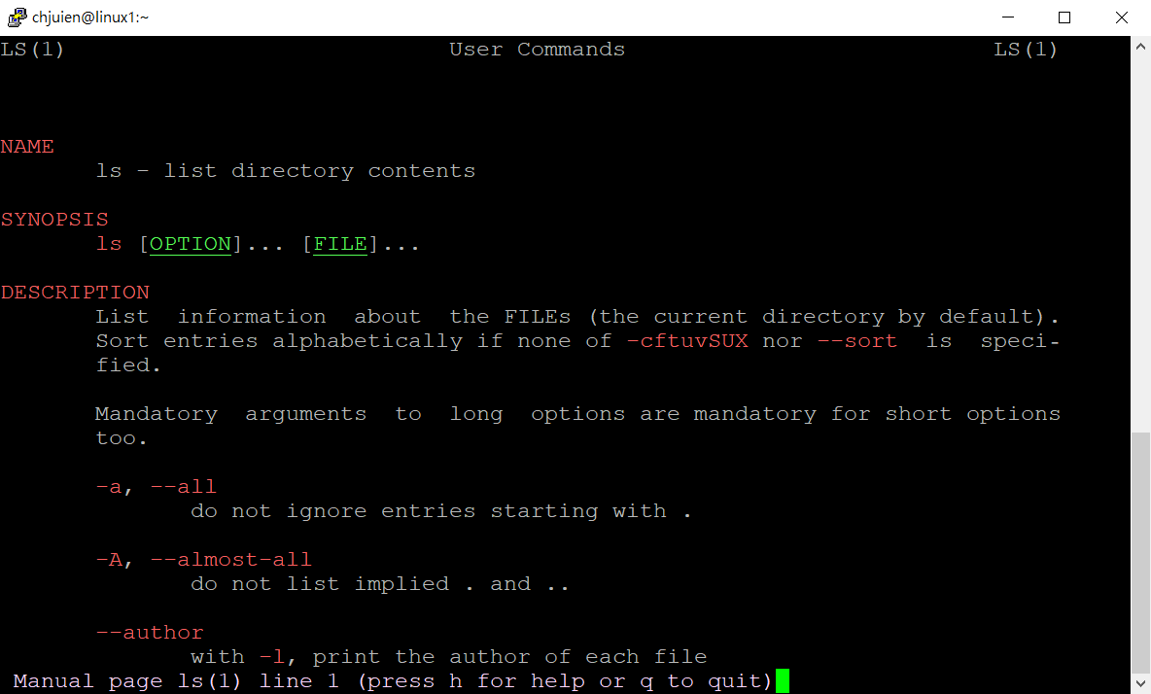
The ‘man’ Command

Slide 31
Outline
Introduction of virtual machine and installation tutorial
How to connect to a remote machine ?
Basic Linux commands
Basic Linux programming
Networking tools on Linux

Slide 32
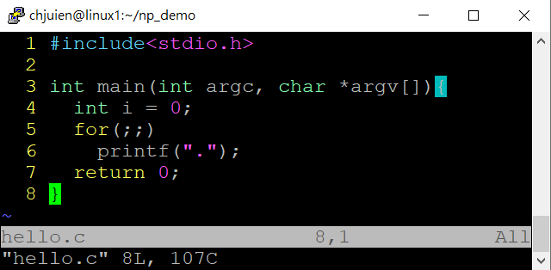
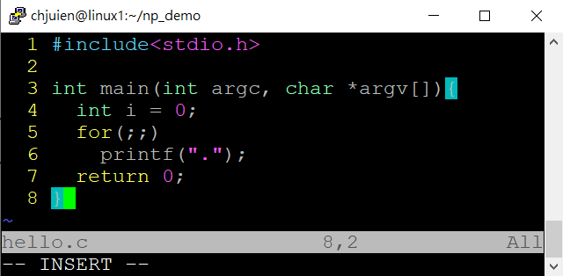
The VIM Text Editor
vim is a text editor
vim hello.c
Press ”insert” or “i” to enter insert mode, or you can type nothing.
Notes:
http://zh.wikipedia.org/wiki/Vim

Slide 33
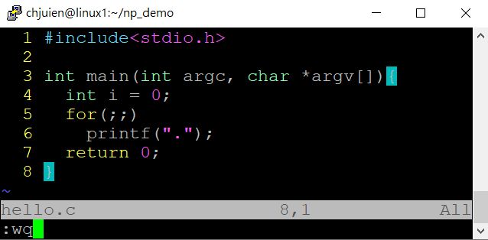
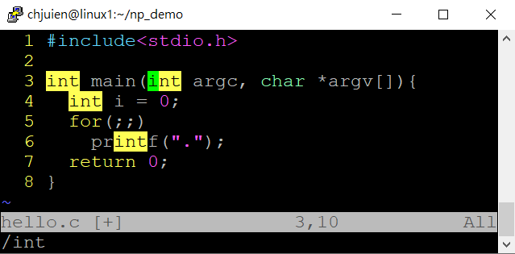
The VIM Text Editor
Press “Esc” to enter back to normal mode, where you can type some commands, including “:wq” for saving and leaving, “:q!” for leaving without saving, “/int” for searching the string “int”.
You can pick up other usage by your self.

Slide 34
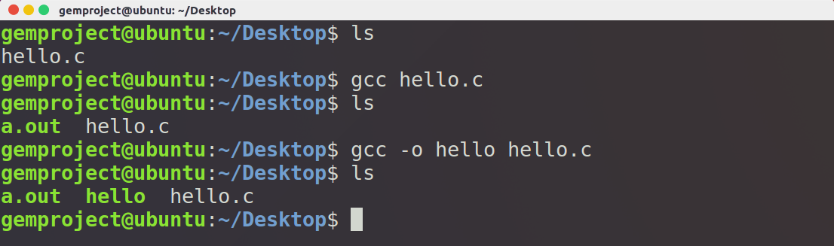
The GCC/G++ Compilers
gcc/g++ –o <output> <filename>
-o
The program produced will be the same name as assigned.
If –o is not provide, a.out will be the default output file name.

Slide 35
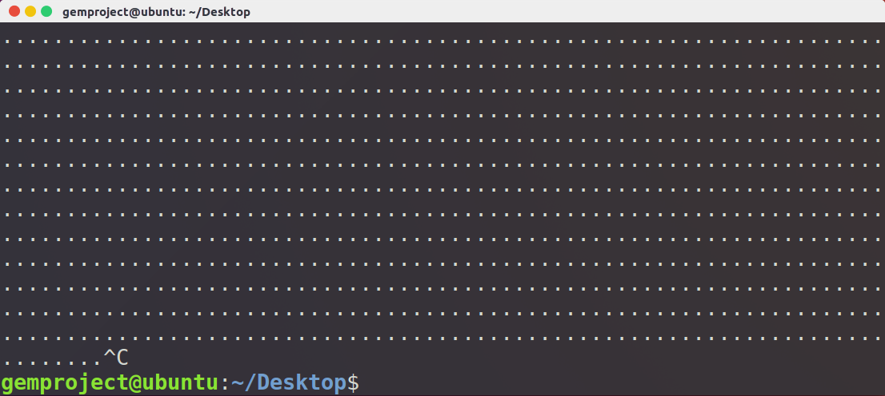
Execute and Forced Terminate a Program
Execute
./a.out
Forced Terminate
Ctrl+c

Slide 36
More explanation

Slide 37
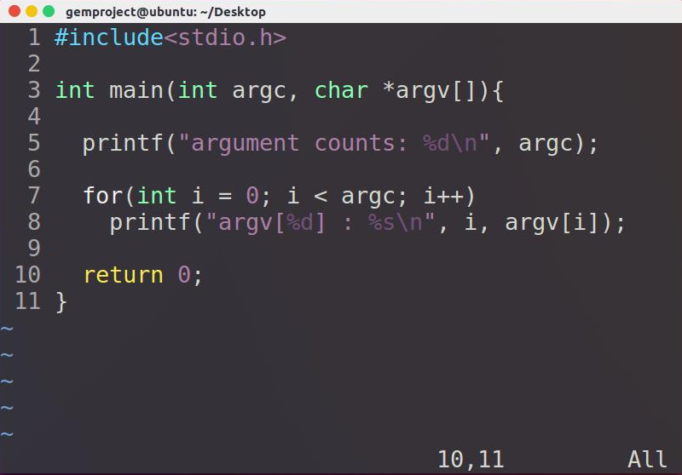
Argument Variables
Argument count
Argument vector

Slide 38
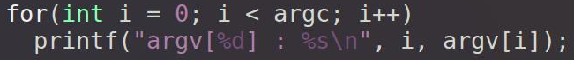
Argument Variables
int main ( int argc, char *argv[])
argc
Integer
The sum of given arguments count, including the program name.
argv
A string array that holds arguments.

Slide 39
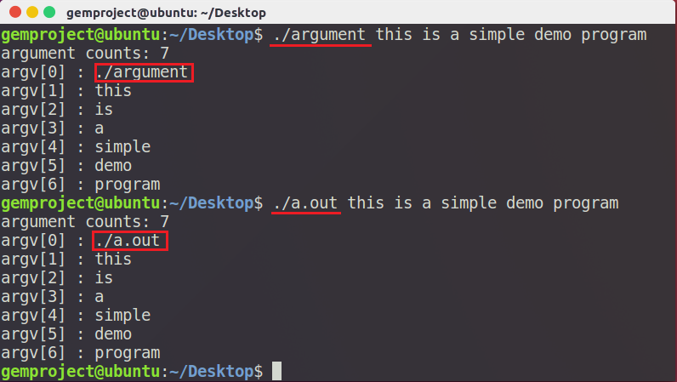
Argument Variables

Slide 40
Process Management Commands
ps
Report a snapshot of the current processes.
ps u
List all of your process in difference login session.
Get process ID
kill
Terminates or send signals to a process
When a process doesn’t go your way or out of control, use this command to terminate it .
kill <pid>
killall
Kill processes by name

Slide 41
Run a Program in Linux
Every command is a executable program (can be the ‘which’ command)
ls -> /bin/ls
vim -> /usr/bin/vim
Environment variables
env
PATH=/usr/local/bin:/usr/bin:/bin:/opt/bin
When user commit an command, if it wasn‘t a shell‘s built-in command, OS will try to search the executable files under the directories specified by PATH.
That means we can‘t just simply type a.out and hope to execute the program we compiled
You have to determine the file path of the output program.
./a.out
~/Desktop/a.out

Slide 42
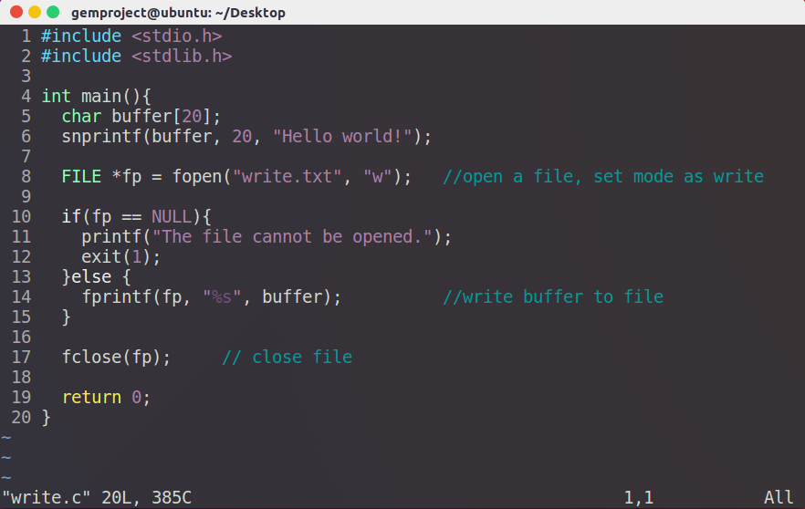
File I/O
Write file

Slide 43
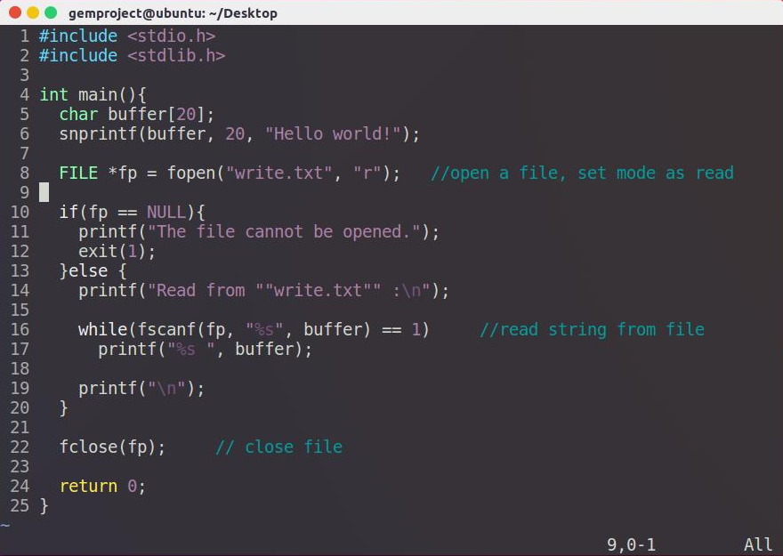
File I/O
Read file

Slide 44
Outline
Introduction of virtual machine and installation tutorial
How to connect to a remote machine ?
Basic Linux command
Basic Linux programming
Networking tools on Linux

Slide 45
Network Related Commands
ifconfig
Show current system NIC
ping <host IP>
Send ICMP packet to host
Simply test if an server is alive
Not working if firewall is set.
Windows 7 default
traceroute <host IP>
Trace the path to the host IP

Slide 46
Capture and Analyze Packets
Command line interface:
tcpdump
Graphical User Interface:
Wireshark

Slide 47
What is tcpdump?
Packet analyzer runs under the command line.
Works on most unix-like OS.
Support common protocols not just TCP.

Slide 48
How to Install tcpdump
Ubuntu
$ sudo apt-get update
$ sudo apt-get install tcpdump

Slide 49
tcpdump
tcpdump [ -AennqX ] [ -i 網路介面 ] [ -c 數量 ] [ -w 儲存檔案名 ]
-A ：Print each packet in ASCII. Handy for capturing web pages
-e ：Print the link-level header (MAC) on each dump line.
-nn：Print data with IP and port number instead of host name
-X ：print the data of each packet in hex and ASCII
-i ：Listen on interface, e.g.: eth0, lo, ppp0
-c ：Exit after receiving count packets, if without the parameter, tcpdump will continue capture packets until press [ctrl]-c
-w ：Write the raw packets to file rather than parsing and printing them out.
Notes:
-A ：封包的內容以 ASCII 顯示，通常用來捉取 WWW 的網頁封包資料
-e ：使用資料連接層 (OSI 第二層) 的 MAC 封包資料來顯示
-nn：直接以 IP 及 port number 顯示，而非主機名與服務名稱
-X ：可以列出十六進位 (hex) 以及 ASCII 的封包內容
-i ：後面接要『監聽』的網路介面，例如 eth0, lo, ppp0 等等的介面
-c ：監聽的封包數，如果沒有這個參數， tcpdump 會持續不斷的監聽， 直到使用者輸入 [ctrl]-c 為止。
-w ：如果你要將監聽所得的封包資料儲存下來，後面接檔名
-r 從指定的檔中讀取包(這些包一般通過-w選項產生)；

Slide 50
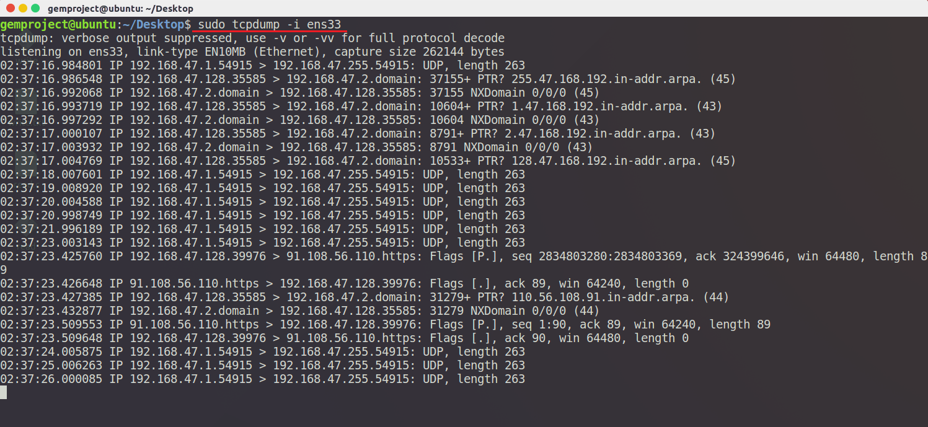
Networking tools on Linux - tcpdump
$ sudo tcpdump –i <interface>

Slide 51
What is Wireshark?
Wireshark is the world's foremost network protocol analyzer. It lets you see what's happening on your network at a microscopic level. It is the de facto (and often de jure) standard across many industries and educational institutions.
Notes:
Wireshark官網介紹

Slide 52
How to Install Wireshark
Ubuntu
$ sudo apt-get update
$ sudo apt-get install wireshark

Slide 53
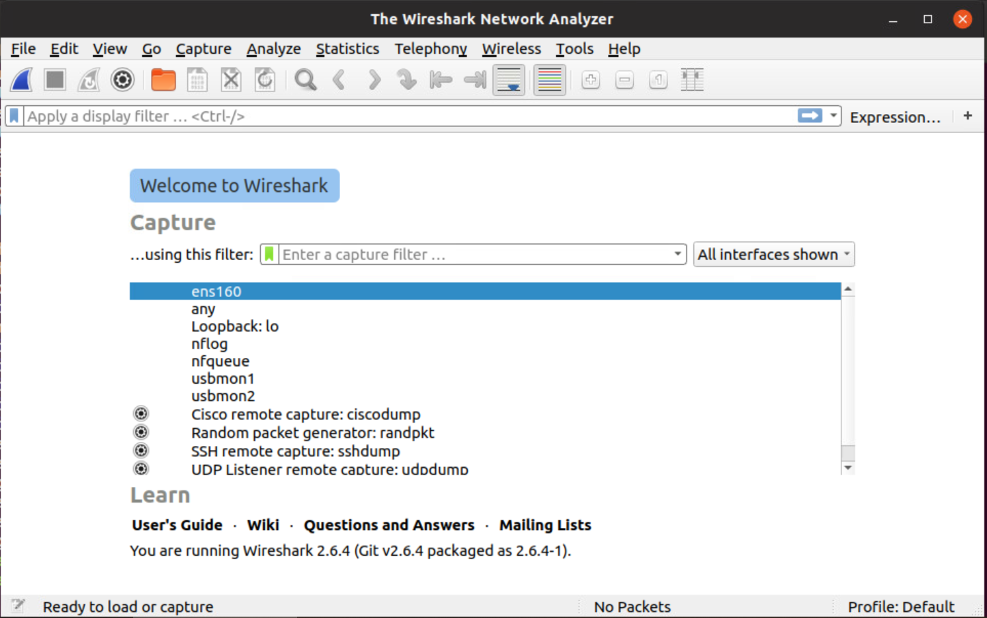
Start Wireshark (I)
$ sudo wireshark

Slide 54
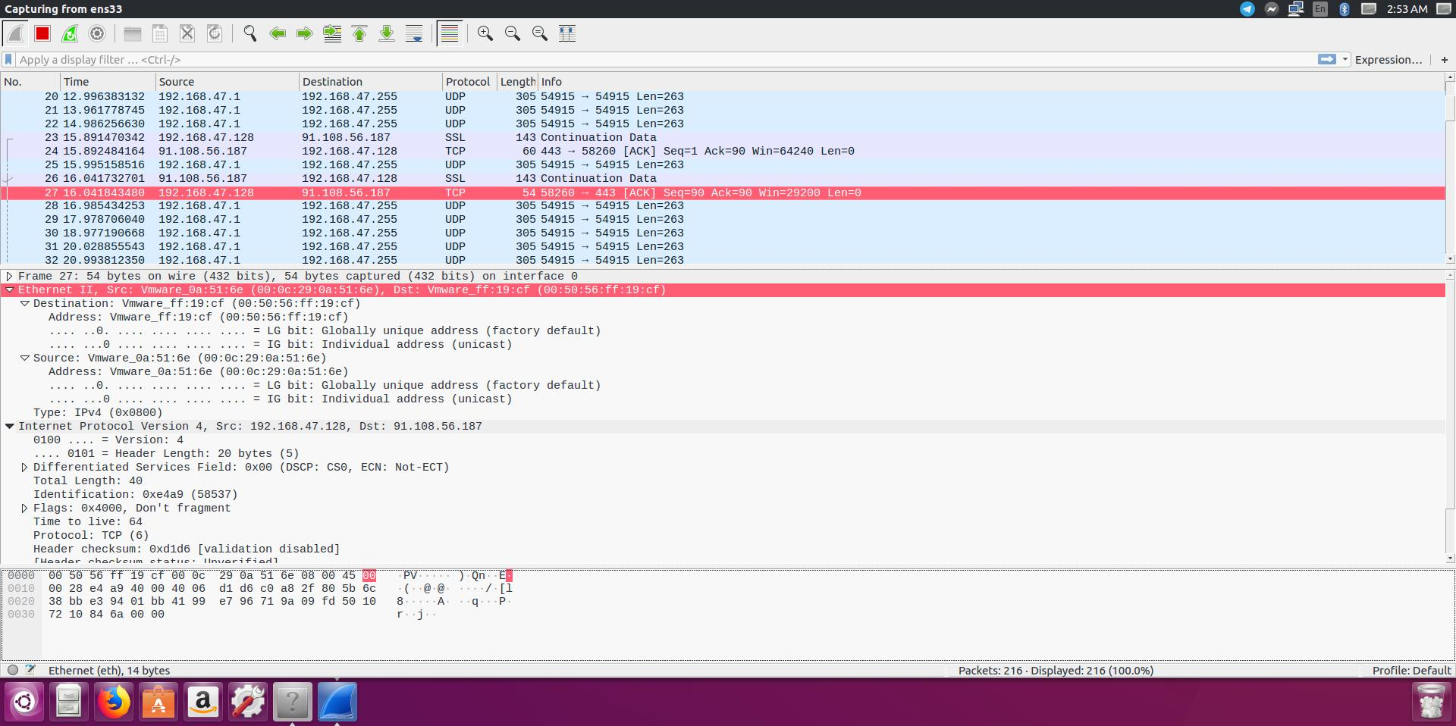
Basic Functions (I)

Slide 55
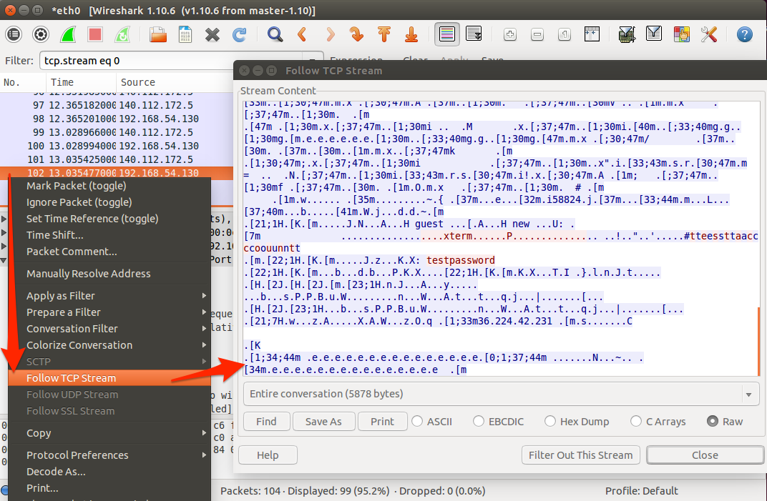
Basic Functions (II)
Notes:
只看這條 tcp stream的

Slide 56
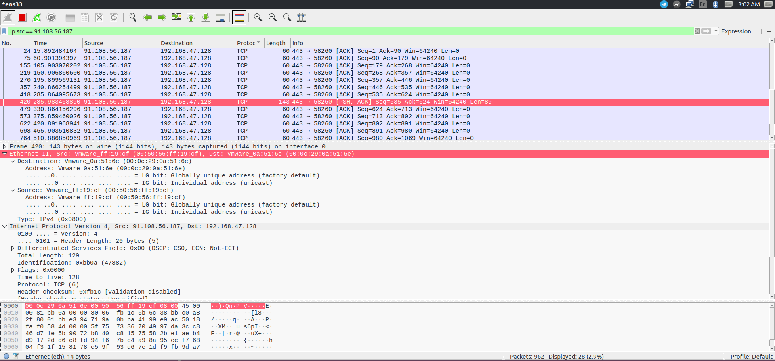
Filtering (I)

Slide 57
Filtering (II)
Common expression
ip.src / ip.dst / ip.addr
tcp / udp / arp
tcp.port / udp.port
Notes:
https://wiki.wireshark.org/OpenFlow

Slide 58
Q & A

